Slide 1
Password Strength:
A
Discrete Mathematics Perspective
Password strength is a critical aspect of cybersecurity, ensuring sensitive information remains protected. This presentation explores the principles and methods behind password strength checkers, drawing connections to concepts within discrete mathematics.
Presented by:
Abeeha 24010
Maha Faisal 24048
Ahmed Abdullah 24012
Zohha Kashif 240126
Sumair Ali 24114

Slide 2
Fundamentals of Password Strength
1
Character Diversity
A strong password incorporates a diverse range of characters, including uppercase and lowercase letters, numbers, and symbols. This creates a significantly larger space of possible combinations, making it more challenging for attackers to guess.
2
Length
Increasing the password length directly enhances its complexity. Even a password with simple characters becomes much harder to guess when its length is extended.
3
4
Avoiding Common Patterns
Repetitive patterns, such as "123456" or "password," are easily detectable and should be avoided. Employing random character combinations, while still
memorable, prevents attackers from using simple
pattern-based attacks.
Unique Passwords
Every account should utilize a distinct password. This principle reduces the risk of compromise across multiple services if one account's password is compromised.

Slide 3
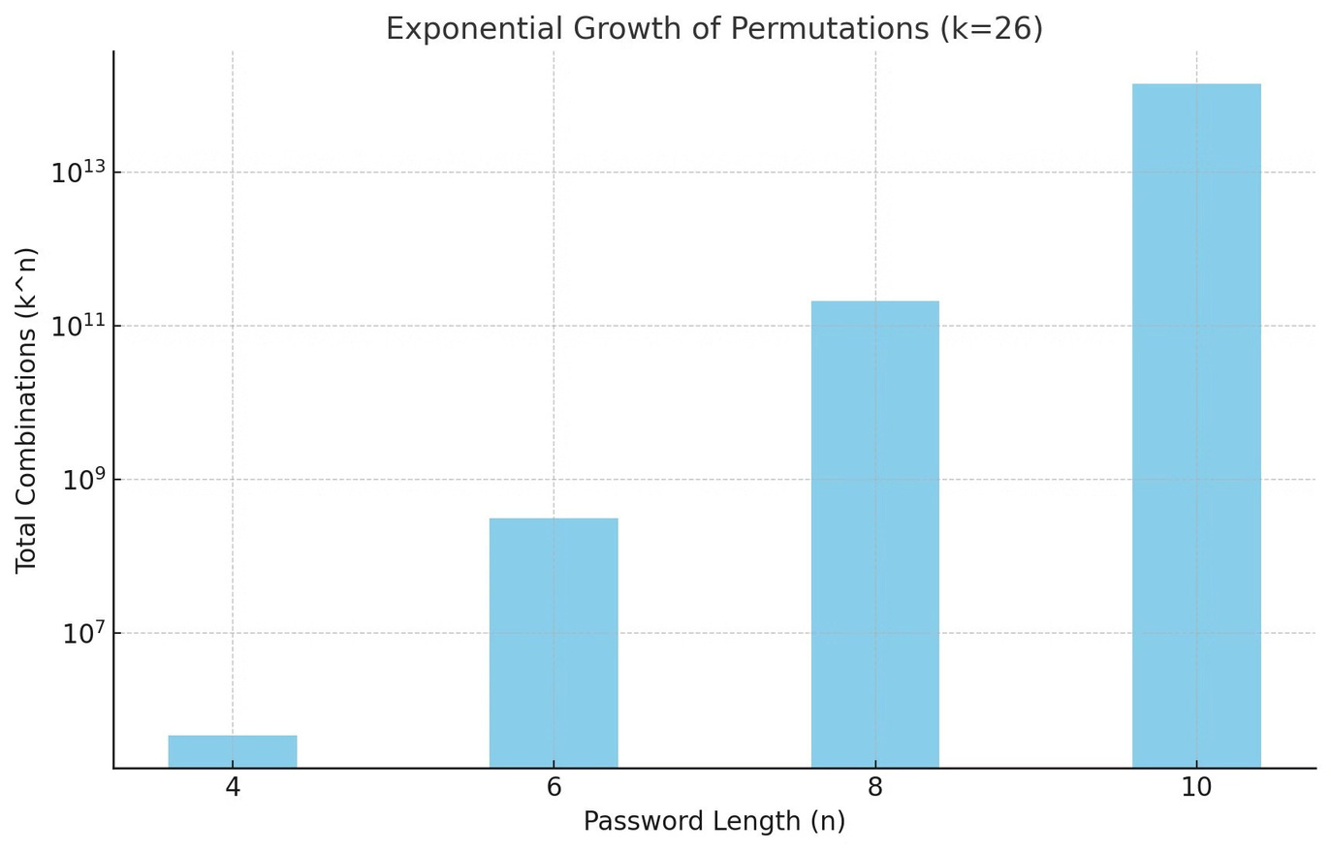
Permutation and Password Strength
1
Concept
Permutations measure the number of unique combinations a password can have, calculated as: k^n Where: - k Total number of characters available (e.g., uppercase letters, digits, symbols). - n: Password length.
2
Importance
As computing power improves, hackers can attempt millions of guesses per second. Strong passwords with more permutations significantly reduce the risk of being cracked.
3
Example
1. Short Password with Limited Characters: -
Password Length (n): 6 - Character Set (k): 26 (lowercase letters only) - Calculation: 26^6=308,915,776 passwords.
2. Longer Password with a Diverse Character Set: - Password Length (n): 8 - Character Set (k): 72 (uppercase, lowercase, special characters). - Calculation: 72^8=722,204,136,308,736 passwords.
4
Key Takeaway
Exponential Growth: As shown in examples. Adding even one character to n or expanding k drastically increases permutations and password strength.

Slide 4
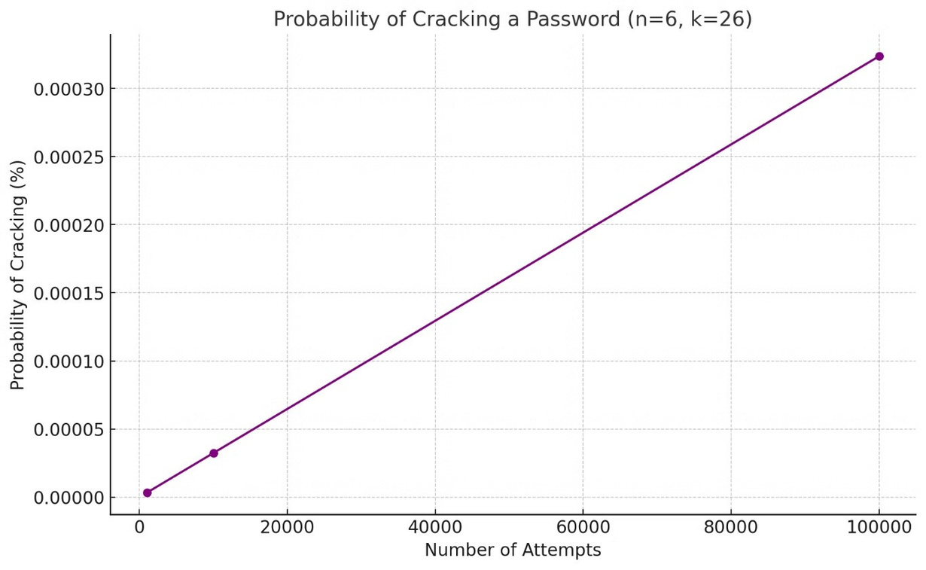
Discrete Probability and Password Cracking
Concept:
Password cracking involves systematically guessing passwords within a finite search space (k^n). - Probability Formula: Probability = Number of Attempts / k^n
Example
- Password Length (n): 4 - Character Set (k): 10 (digits only). - Total Combinations: 10^4=10,000. - If an attacker makes 1,000 guesses. - Probability = 1000/10,000 =0.1=10%.
Insights
- Larger k^n values drastically reduce the probability of successful guessing. - Stronger passwords with higher k^n values are insights - Larger k^n values drastically reduce the
probability of successful guessing. -
Stronger passwords with higher k^n
values ae more secure.

Slide 5
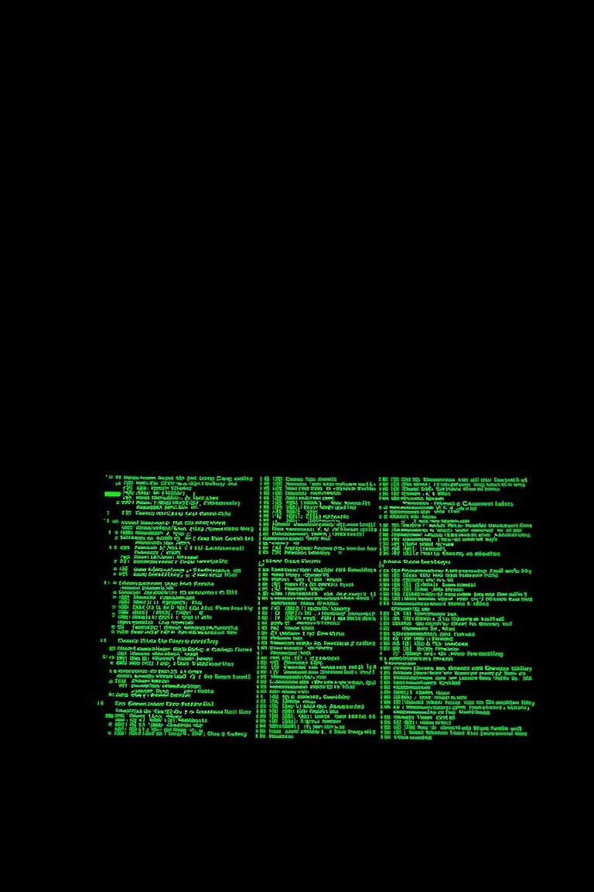
Threats to Password Security
Brute-Force Attacks:
Systematically tries every possible password within the search space (k^n). - Exhaustive
but effective for small n or k.
Dictionary Attacks
Targets common or predictable passwords using a precompiled list (e.g., "password123,"
"qwerty"). - Relies on human
tendencies to choose easy-to-
remember passwords.

Slide 6
Combinatorics and Secure Password Generation
Concept:
Combinatorics: The branch of mathematics dealing with counting combinations and arrangements. - Power Set: The set of all possible subsets of a given set, including the empty set. - Total subsets of a set with k elements: 2^k.
1
Application in Password Generation:
1. Example: - Character Set (SSS): {A, b, 1, @}. - Power Set of SSS: {∅, {A}, {b},{1},{@},{A,b},{A,1},{A,b,1,@},…}. - Total subsets = 2^4=16. 2. Use: - Generate random, secure passwords by combining subsets from the power set. - Exclude the empty set (2^k −1) to ensure meaningful passwords.
2
Advantages:
- Scalability: Adapts to different security levels by modifying k or n. - Flexibility: Supports user-specific policies (e.g., requiring symbols). - Randomness: Reduces predictability and ensures diversity in password structures.
3

Slide 7
Algorithm of the password strength checker
Strength Checking Method:
Complexity Analysis:
Unique features :
The code we have written prevents
from password strength checker
The program evaluates password
strength by calculating a
"permutation" value
The permutation is calculated
based on the unique character
types in the password:
1.
Time Complexity:
Password Strength Check: O(n)
Single pass through
password characters
n = password length
Checks against a common
passwords
Prevents repeated consecutive
characters by counting them as
for example"aaaaa" will count as
only one a character but "ababab"
count as 6.
Supports both password checking
Generates a random password
through random function.
Password Generation:
O(length)
Uppercase letters: 26
possibilities
Lowercase letters: 26
possibilities
Numerical digits: 10
possibilities
Special characters: 33
possibilities
Generates password by
randomly selecting
characters
2.
Space Complexity: O(1)
Uses fixed-size arrays Space doesn't grow with input
size
3: Big omega will be (1)

Slide 8
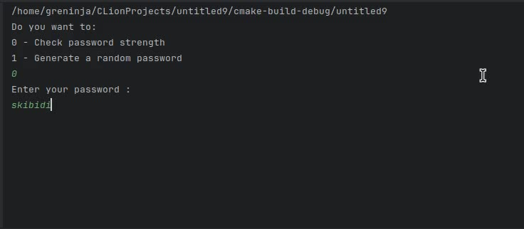

Slide 9
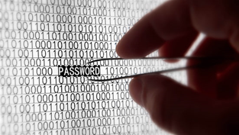
Real-World Applications
Usage in User Systems
User Registration: Ensures users create secure passwords, reducing the risk of account breaches during signups.
Web Applications: Real-time strength checkers help evaluate and enhance password security online.
Mobile Apps: Integrated tools guide users toward creating strong passwords in apps, improving overall security.

Slide 10

Best Practices for Secure Passwords
Creating Strong Passwords
Combine different character types to make passwords harder to guess or crack.
Avoid personal information and predictable patterns like names or sequential numbers.
Educating Users:
Awareness campaigns teach the importance of unique, strong, passwords to prevent cyber threats.
Regular training sessions help users stay updated on latest password security practices
Tools for Password Management
Password Managers: Tools generate and securely store strong passwords for multiple accounts.
Multi-Factor Authentication: Adds a secondary verification method, making unauthorized access nearly impossible.

Slide 11

Conclusion:
By understanding the mathematical principles behind password security, we can make informed decisions to protect our digital assets. Implementing strong passwords, utilizing two-factor authentication, and staying vigilant against common threats are essential steps in safeguarding our online presence. As technology evolves, so too must our approach to password security, ensuring
that our data remains safe and secure in the digital age.

